Slide 1
Kiribati (Keer ee bas)
The First Climate Change Refugees?

Slide 2
Mauri Oh (Hello)
Chris Brown – Teacher, Professor, Learner
I lived in the country of Kiribati for 2 ½ years from 1990 until 1992. as a Peace Corps volunteer.
Lived on the island of Marakei which had no electricity, running water or communication.
Was director of a small low tech vo tech where we installed simple pumps into the open wells.
Where is it?

Slide 3
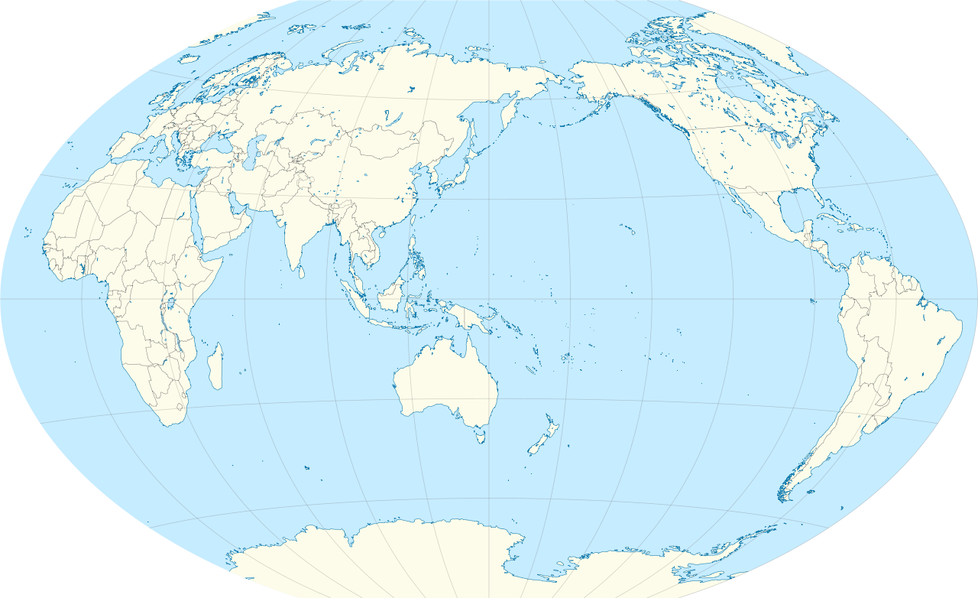
Where in the World is Kiribati

Slide 4
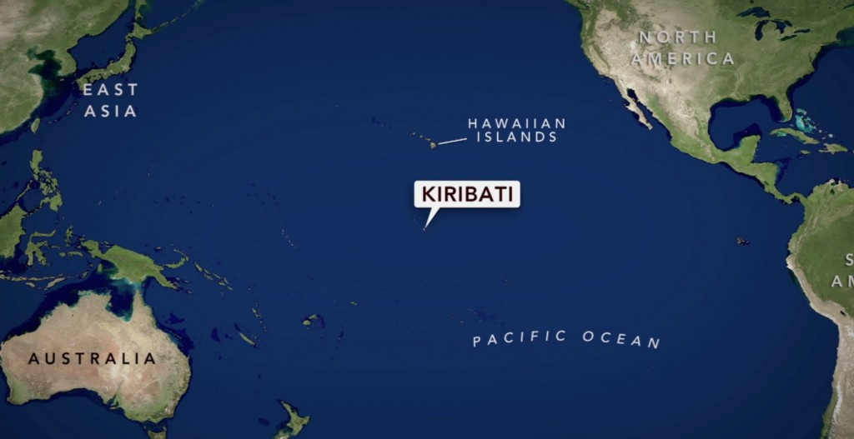
https://www.google.com/maps/@2.0514575,173.2638111,10118346m/data=!3m1!1e3

Slide 5
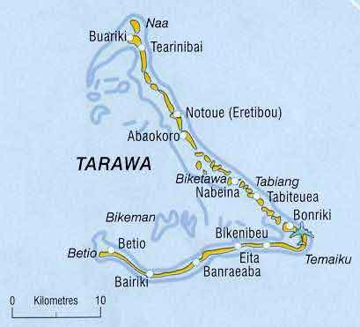
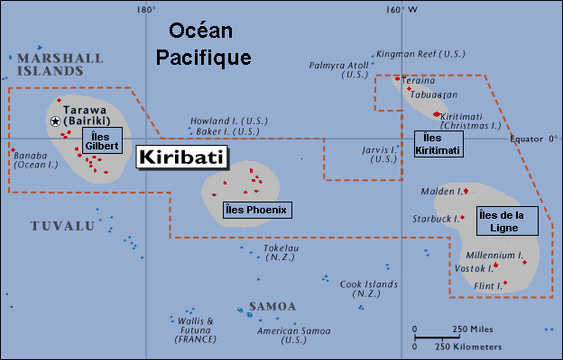
Kiribati Statistics
Kiribati U.S.
Capital Tarawa Island (Bairiki) Wash D.C.
Total population 100,000 thousand 320 Million
Life expectancy 52 years 79 years
Infant mortality 34 deaths/1,000 6 deaths/1,000
Size - 1.35 million sq mi - sea 6,100,000 sq mi 400 sq miles – land (33 islands)

Slide 6
Kiribati – What is it like to live there? (Environment)
What is the land like?
What is the climate / weather like:
What kind of plants are there?
What animals live there?
What kind of food do the people eat?
What do they do for entertainment?
How do they dispose of their waste?
How do the people get their electricity, drinking water?

Slide 7
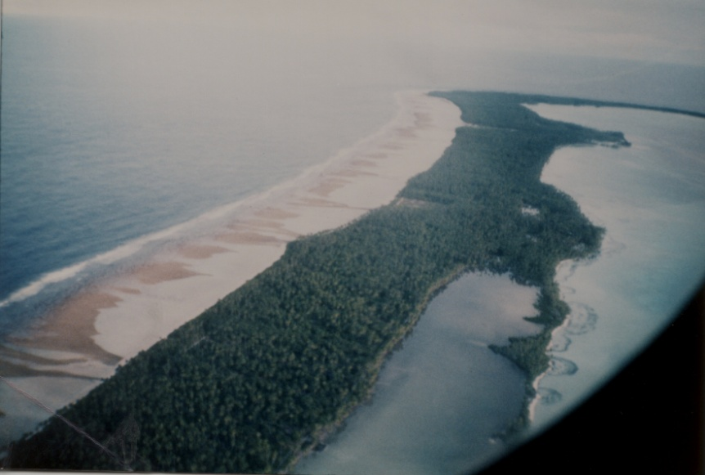
The land of Kiribati – Living on an Atoll
An atoll is a very flat piece of land that is made of old coral that grew around an old volcano?
How were atolls formed?
Atoll formation

Slide 8
Kiribati Weather
Hot Hot Hot - all year long.
Frequent late afternoon rains
Windy and rainy from November to March
Sun-up at 6 AM and sun-down at 6 PM – Every day. Why?
https://weather.com/weather/tenday/l/KRXX0002:1:KR

Slide 9
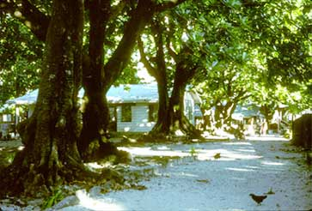
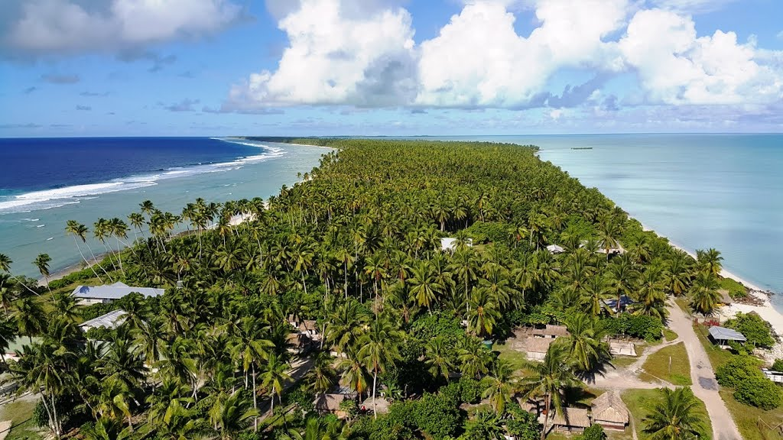
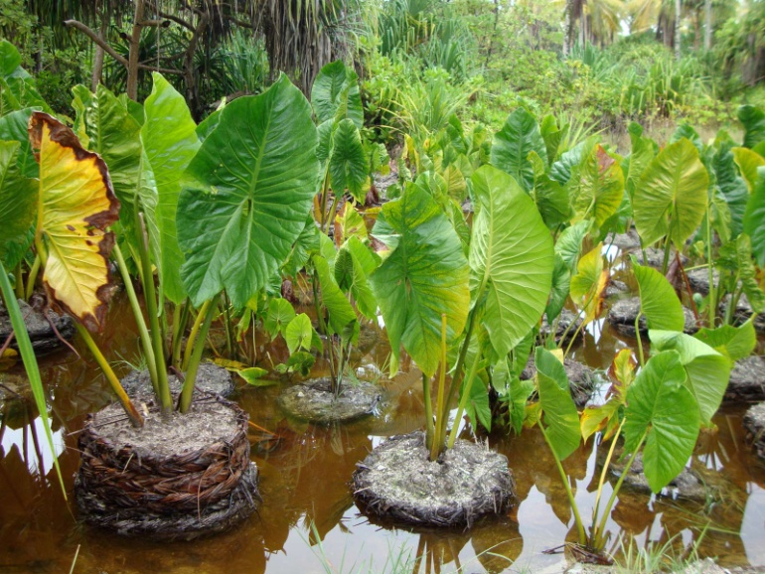
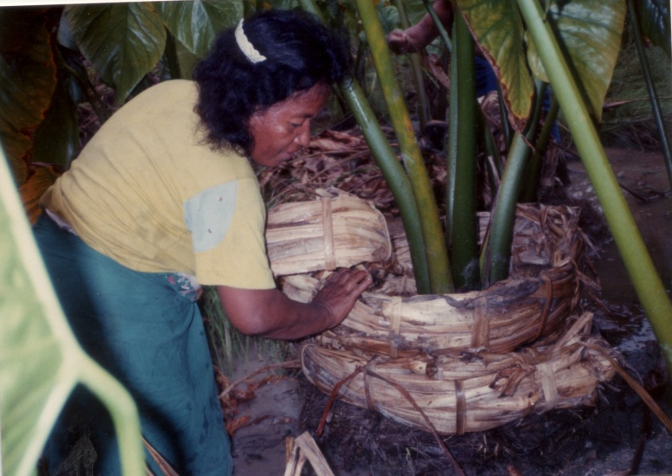
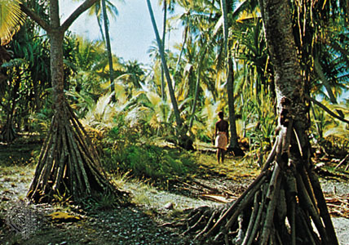
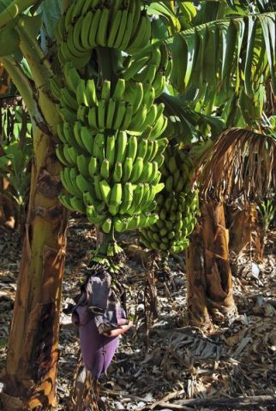
Kiribati Vegetation

Slide 10
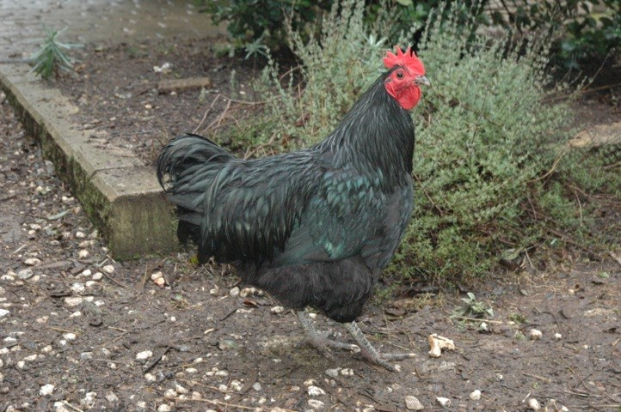
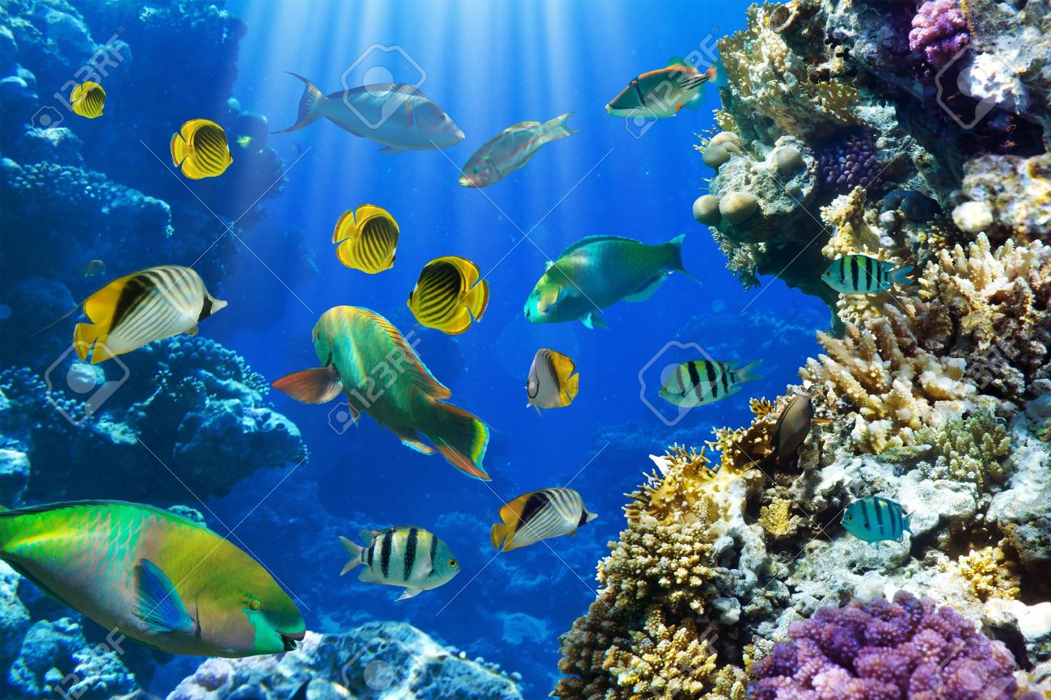
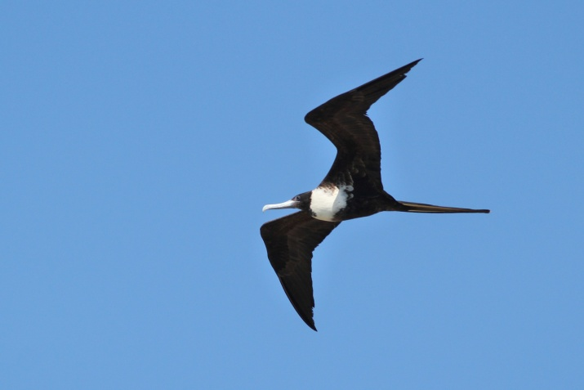
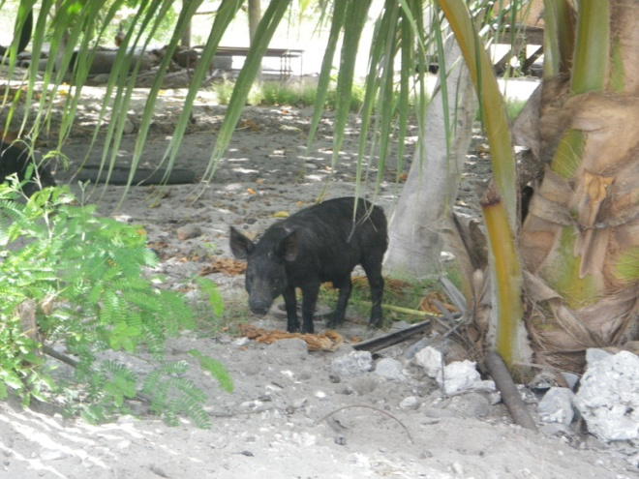
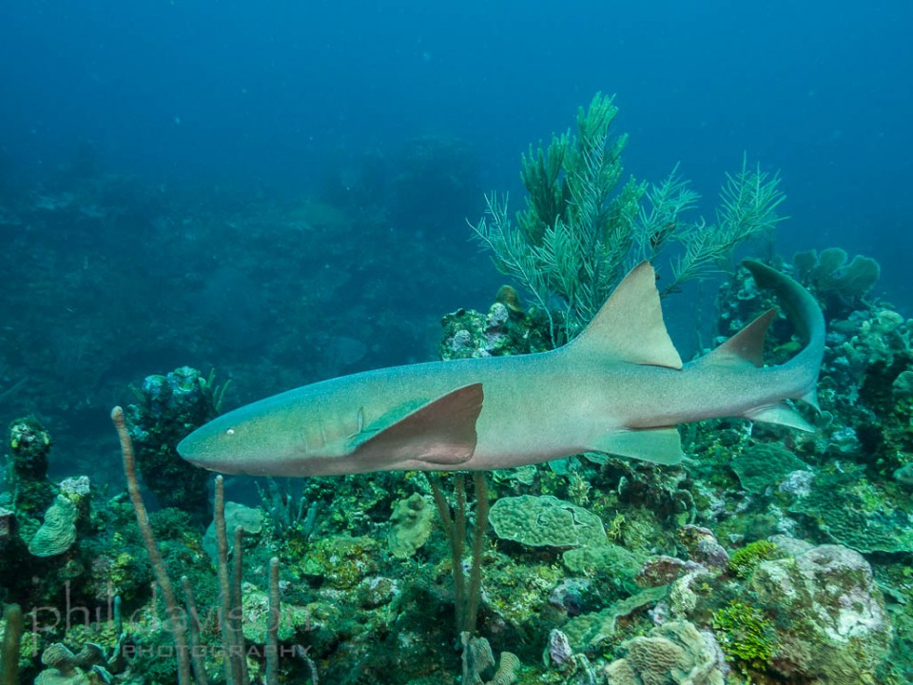
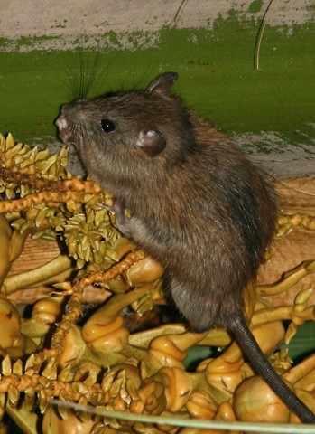
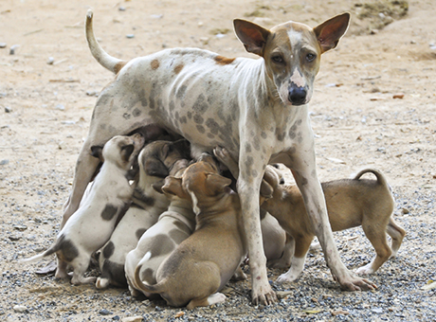
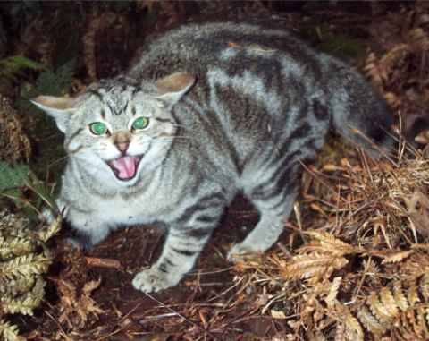
Kiribati Animals

Slide 11
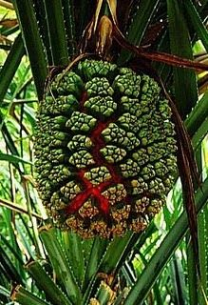
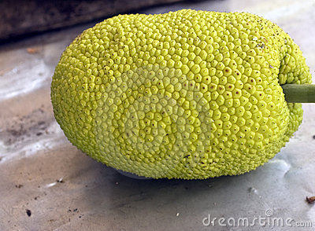
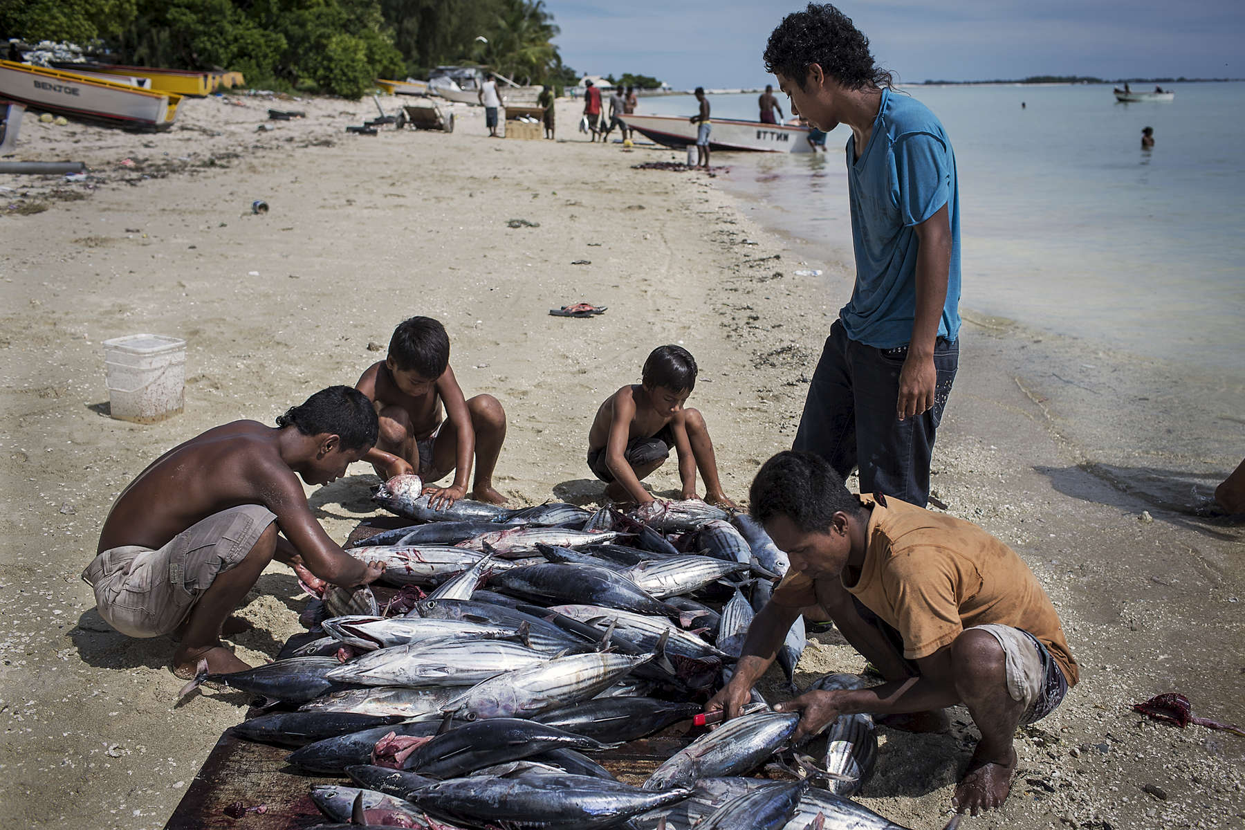
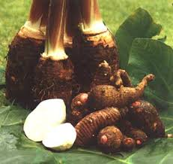
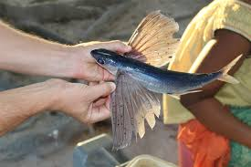
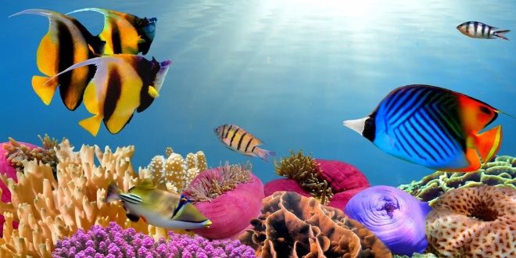
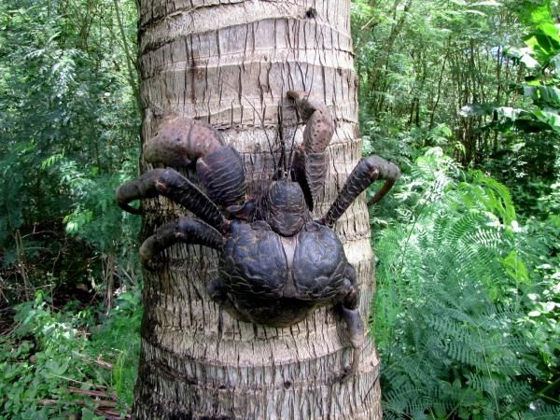
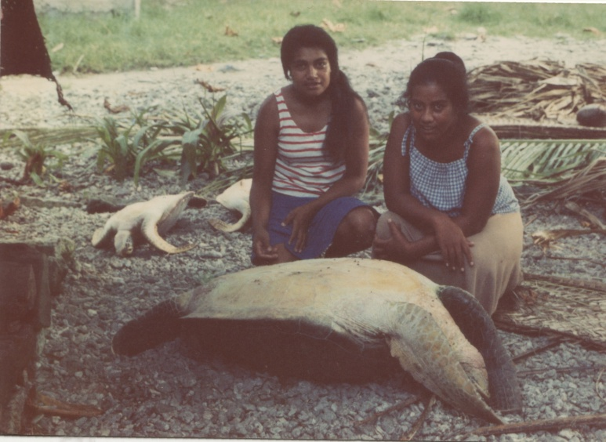
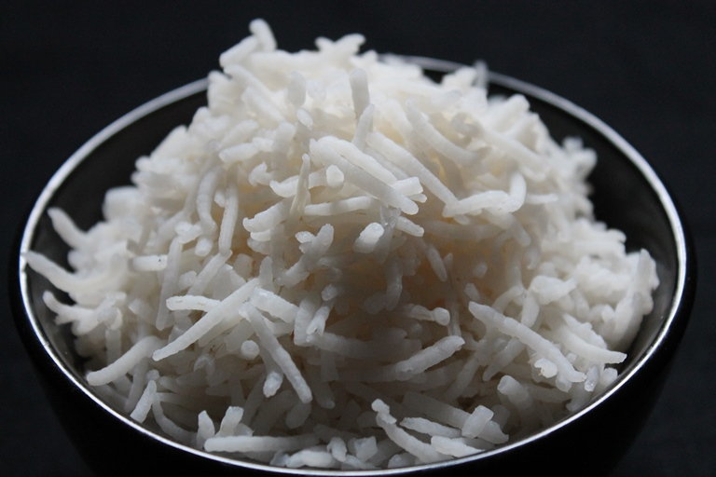
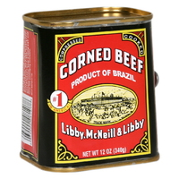
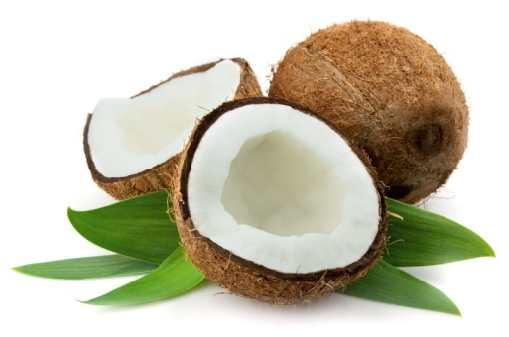
Kiribati Food

Slide 12
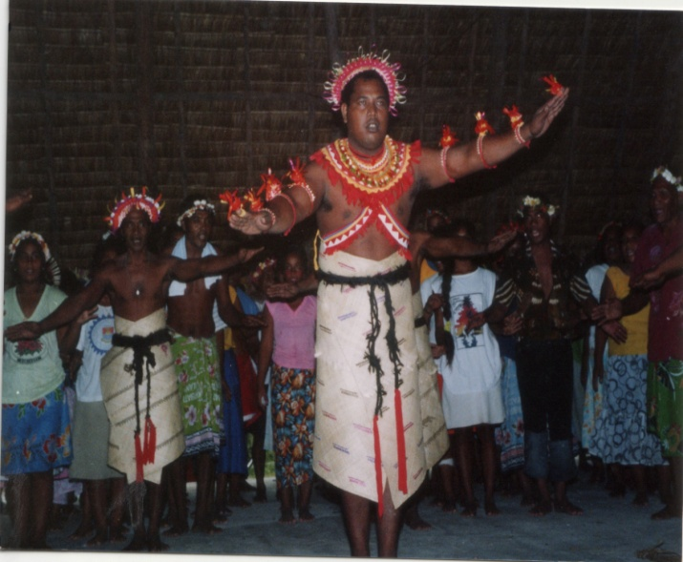
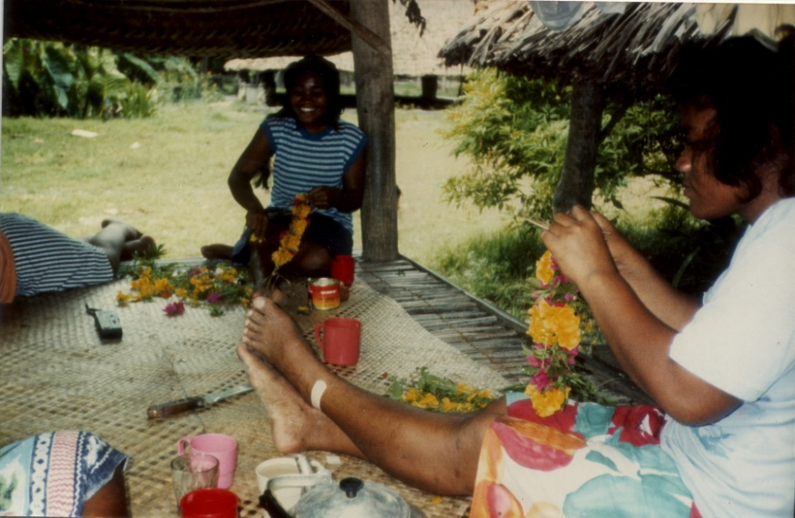
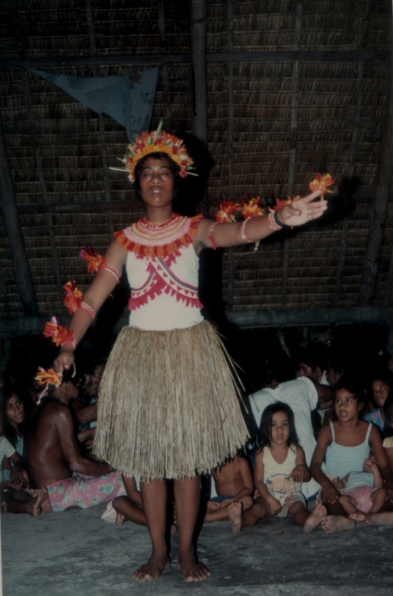
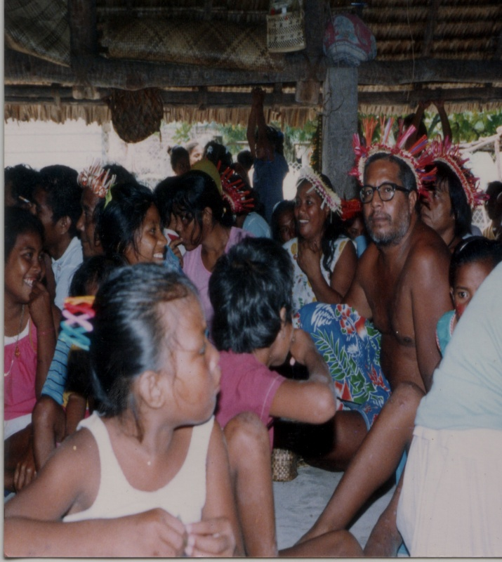
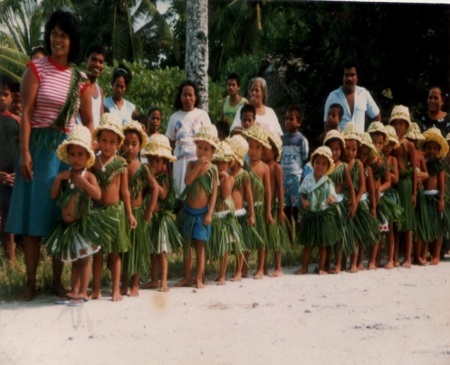
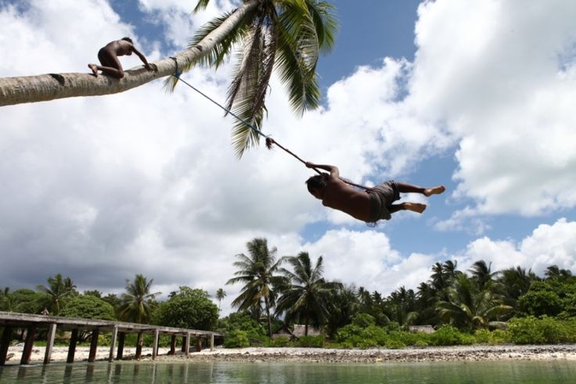
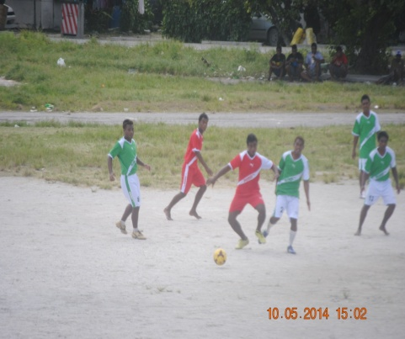
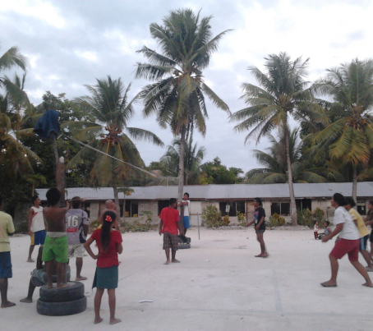
Entertainment in Kiribati

Slide 13
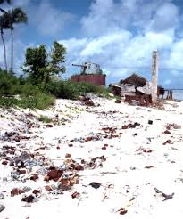
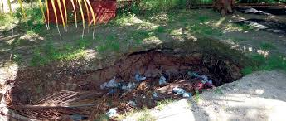
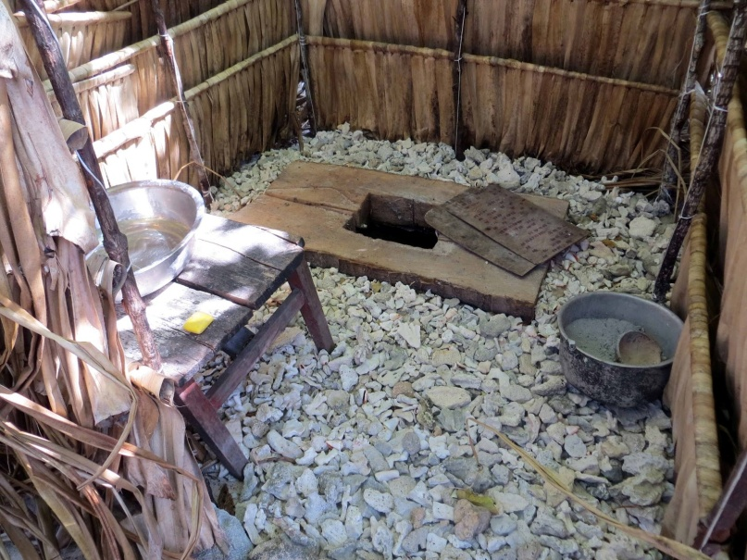
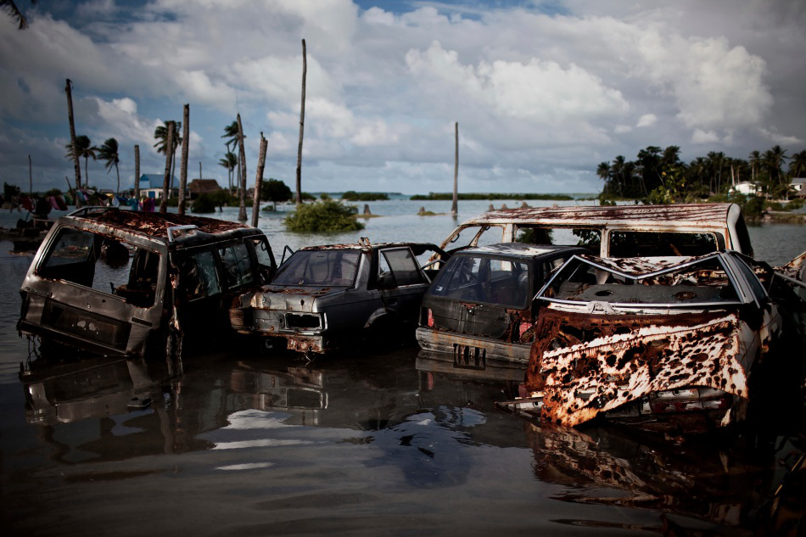
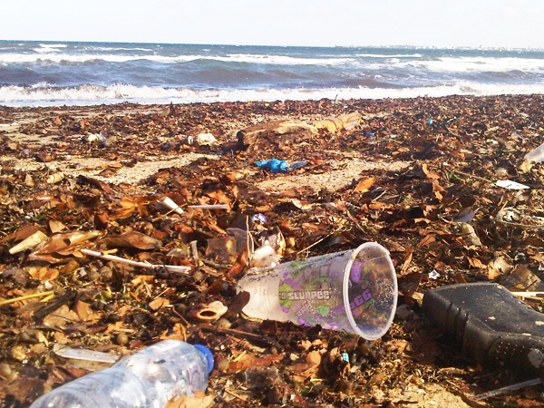
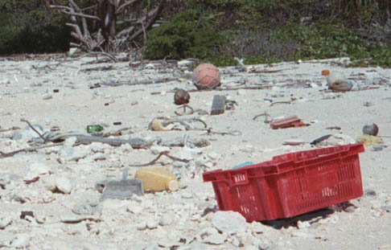
Disposing Waste in Kiribati

Slide 14
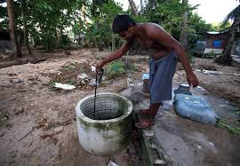
Drinking Water
How do the Kiribati people get their fresh water?
How can the water be fresh when the island is surrounded by salt water?

Slide 15
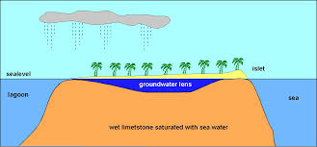
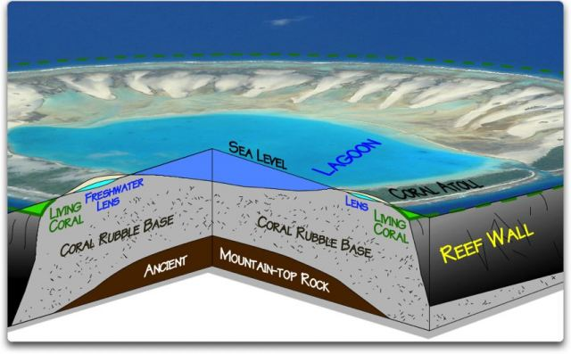
Fresh water on an Atoll
The fresh water sits on a “fresh water lens”.
The fresh water lens is very fragile and could easily become contaminated by pollution or salt water if ocean water seeps in.

Slide 16
Loosing Fresh Water
What will happen to the fresh water if the ocean, which is salt water, rises?
What will happen to the people if they lose their fresh water?
Where will they go?
What might be causing the oceans to rise?

Slide 17
As ocean temperatures rise (even slightly) how might this affect the Kiribati food supply?

Slide 18
What should the people of Kiribati do to preserve their land, country and way of life? Kiribati – A Drowning Paradise in the South Pacific For more information on Kiribati, you can go to my website at www.beyondthewallseducation.com

Slide 19
What is Global Climate Change
Climate change refers to any significant change in the measures of climate lasting for an extended period of time. In other words, climate change includes major changes in temperature, precipitation, or wind patterns, among other effects, that occur over several decades or longer.
Global warming refers to the recent and ongoing rise in global average temperature near Earth's surface. It is caused mostly by increasing concentrations of greenhouse gases in the atmosphere. Global warming is causing climate patterns to change. However, global warming itself represents only one aspect of climate change
http://ec.europa.eu/clima/change/causes/index_en.htm

Slide 20
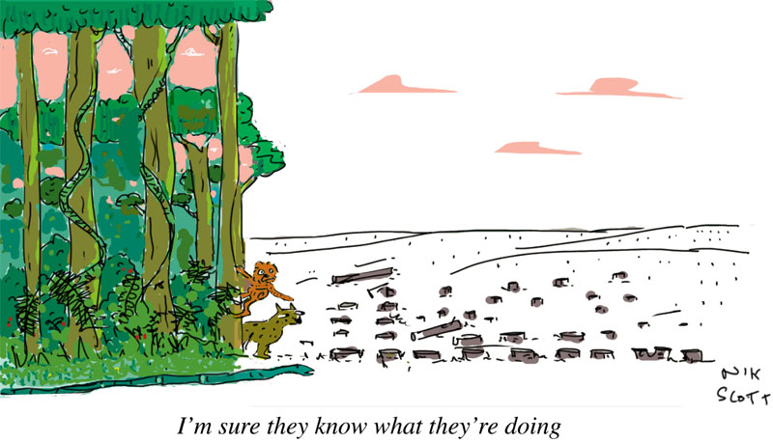
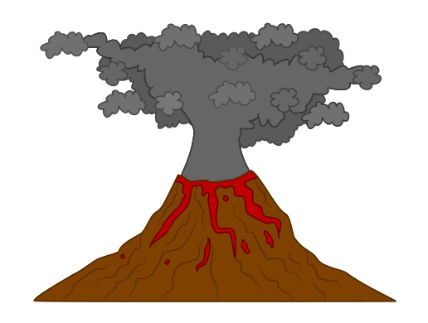
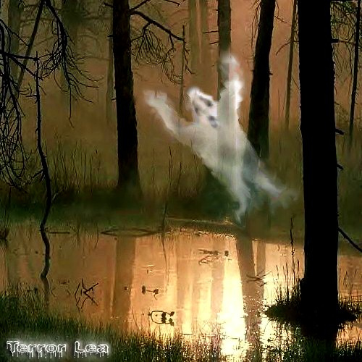
Causes of Global Climate Change
What causes global climate change?
Natural Green House Gas(GHG) emissions - Carbon Dioxide (Co2), Methane(CH4), Water Vapor (H2o) which traps heat within our atmosphere.
Natural: Volcanoes, exhaling and passing gas, swamp gas, global vegetation changes, earth orbital changes.
What human activity has lead to rapid climate change?
Human induced causes of increased (GHG) emissions -fossil fuel use for energy and transportation (coal and oil), increased factory farming leading to methane increase and deforestation in many different forms.

Slide 21
Diagram of GHG effects
Climate Change – The Effects

Slide 22
Co2 and Temperature change over the last 165 years

Slide 23
What is the relationship between glaciers, the North and South Poles and countries like Kiribati?

Slide 24
What about other low lying countries like Kiribati?
With your group discuss what other countries, regions or areas in the world could also be affected by the same problems that face Kiribati.
Make a list of the countries you think could have the same problems
On your map shade in the areas of the world with your colored pencil that you think could also be affected.
7 Minutes

Slide 25
What countries did you think of?
Kiribati (100,000)
Tuvalu (50,000)
Maldives (325,000)
Tonga (250,000)
Solomon Islands (600,000)
Micronesia (120,000)
Indonesia (30 million)
Marshall Islands (90,000)
Seychelles (100,000)
Bangladesh (40 Million)
Australia (3 million)
China (20 Million)
United States (30 million)
New Zealand (2 Million)
Japan (15 million)
Philippines (15 million)
Virgin Island + (2 million)
Cuba (3 million)
How many people is this in total?
161 Million

Slide 26
Worlds most vulnerable areas due to rising sea levels

Slide 27
Where will all of these people go if they lose the land they live on?
How will this affect the rest of the world?

Slide 28
Is There Hope?
What do you think the following pictures are of and how are they related to climate change solutions?

Slide 29
Global Warming Solutions
The solutions to stopping human created climate change are many. Some of them require international cooperation between countries and others are things we can do personally.
With your group think of three things that can be done to slow down or stop Global Warming on an international scale and three thing you can do locally (yourself or your friends and family).
5 Minutes

Slide 30
Currently being done
More solar and wind energy being produced.
More people eating locally produced foods
More investment into Mass Transit (trains, busses, trolleys etc.)
More electric vehicles and efficient gas burning vehicles
Paris Agreement 2015 – Countries agree to reduce GHG emissions – factories use less coal and “scrub” their emissions
Less Methane leaking from Oil wells – make it mandatory for companies to install equipment to capture lost methane. Same with factory farms

Slide 31
Actions You can take
Walk, bike and ride public transportation (busses and trains) whenever possible.
Eat locally grown foods when ever possible.
Grow a garden and eat from it –go to a farmers market
Plant a tree(s) - on your own or volunteer
Use less paper
Use electricity more efficiently – Think about how you currently use it and are there ways to reduce the amount you use.
Talk about this issue with others – Don’t be silent!
Write letters to your elected officials – Senators, Representatives, Mayors , etc – with ideas and concerns
Don’t be fearful – Be bold!

Slide 32
Ko Raba and Tiabo (Thank You and good bye)
Any questions or thoughts?

